Slide 1

Duolingo
The leading language learning app

Slide 2

Overview
The current mission statement/values Duolingo has is - “To make language learning accessible to all”
The current CEO of Duolingo states the two best decisions they made as a company was:
  Giving the product away for free
  Making the learning fun through gamification
Family fun to improve travel experience
Notes:
The current Duolingo approach is benefits based however advertisement will include a portion of features based such as their 100+ languages available on the platform – these core concepts will be retained as well as built upon.

Slide 3

The STP Process
Product
Price
Define Market
Place
Segment Market
Promotion
Target a Segment
People
Position
Process
Physical Evidence
Notes:
Following McCarthy’s STP Process we can effectively breakdown Duolingo’s audience as well as the gaps in the market

Slide 4
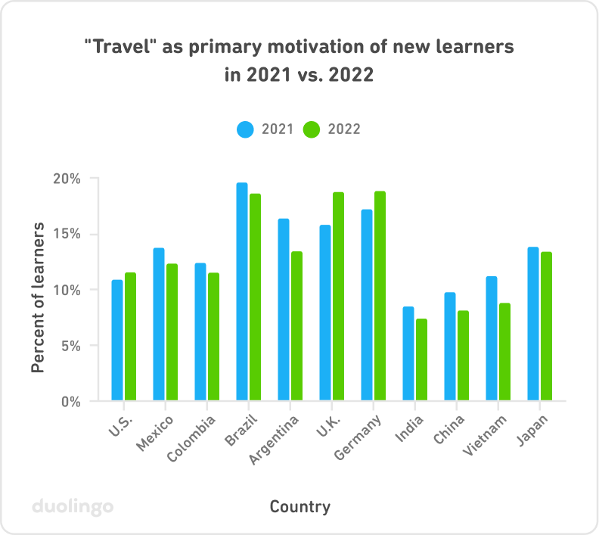
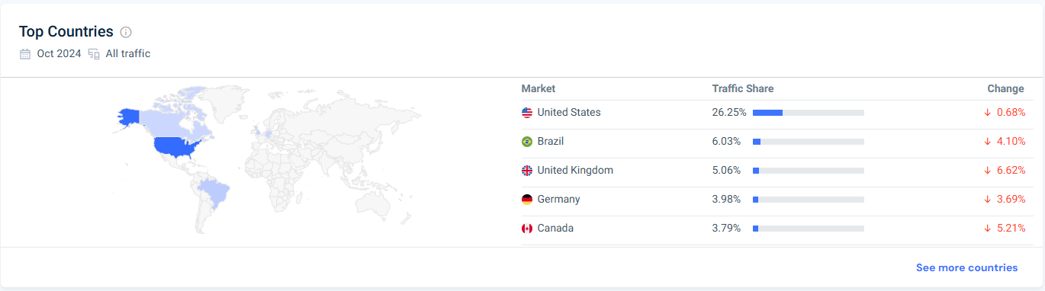
Target Audience: Segmentation
The UK is the third biggest users of Duolingo
Nearly 20% of Duolingo users in the UK as of 2022 stated their primary motivation for using Duolingo is Travel.

Slide 5
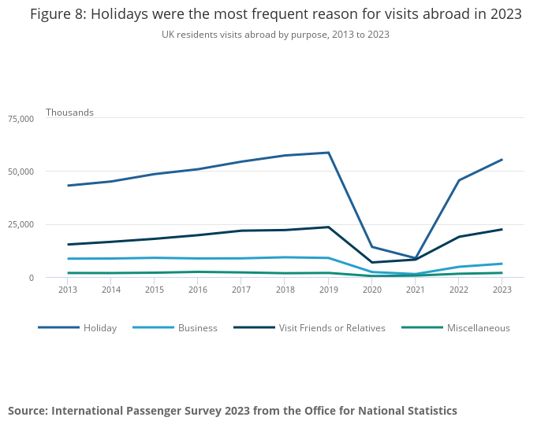
Target Audience: Segmentation
You can also see after the dip in travel due to COVID-19, UK residents have been increasing their travel year-by-year and is nearly at the same amount as before the pandemic.
As of 2023 about 84% of UK residents went on holiday. 52% of those travelled abroad.
Notes:
58% of young families went overseas (up from 56%) as did 57% of older families (up from 50% in 2022)
Looking at families, like last year, those with younger children went on holiday abroad more often than those with older children, with young families taking an average of 2.3 trips and older families taking an average of 1.7 trips in the last 12 months.

Slide 6

Target Audience: Targeting
Ages between 35-54 – 30.47%
Parents of various sized families
Esteem Needs
Notes:
This target audience will be the ones who will have an aged family capable of enjoying duolingo to its fullest but also be financially secure enough to afford duolingo alongside their travels abroad.
Following Maslow’s hierarchy of needs these people would be at the self-esteem stage, wanting to separate themselves from the rest of the regular travellers by differentiating themselves with a new language which they will compete against family for bragging rights but to also achieve status on a smaller scale of their family.

Slide 7

Marketing Communications Objective
Increase awareness of the family subscription
Increase customer acquisition of people aged 35-54
Improve Duolingo's perception as a credible language learning service
Create a perception of a family activity

Slide 8
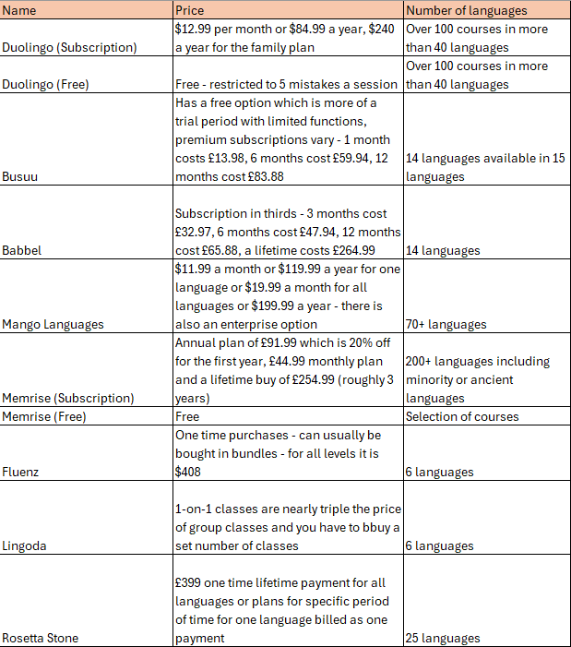
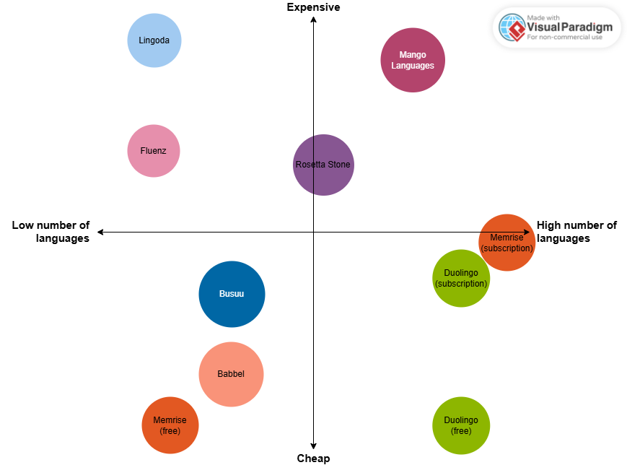
Positioning & Brand Strategy: Perceptual Mapping
Notes:
Duolingo is the third most expensive subscription of its field with the second most available languages but the most available courses for multiple languages.
This places duolingo with a big competitive advantage over most of its competitors and being the third cheapest indicates credibility to its learning process.
This is also true for the free version however this time, it is the cheapest of its field, allowing users to get the full experience but for nothing, there is a few obstacles such as the ‘hearts’ game mechanic which limits users to 5 mistakes before they must stop. These kind of inconveniences push audiences to a subscription or a trial subscription to continue their fun gamified learning.
This strategy is very reminiscent of Spotify and once users have a feel for the paid experience and the added conveniences they are less likely to go back to the free version.

Slide 9
Positioning & Brand Strategy: Brand Equity Model
Salience – Duolingo has a very recognisable brand logo and mascot in their owl
Salience
Notes:
Being a brand leader in the language learning sector meaning it has a very recognisable brand logo and mascot in their owl – while this bird may not mean much to an audience it is nonetheless distinct and works as a symbol to inform people that a green owl or even a green bird represents/connotations to Duolingo.

Slide 10
Positioning & Brand Strategy: Brand Equity Model
Performance – Duolingo provides 100+ courses for multiple languages at an affordable price being the third highest of its competitors
Imagery – Duolingo enables customers to utilise these learnings when traveling to their desired destination
Performance
Imagery
Salience
Notes:
Duolingo being the brand leader and having affordable rates means there is room for some adjustments to pricing – I propose, like many of the other competitors, a lifetime subscription but specifically to one language course. The current pricing plans will stay the same, however, the ability to by a lifetime course means Duolingo can retain customers more, especially if they enjoy the course but also increase their short-term sales which could potentially become long-term sales.

Slide 11
Positioning & Brand Strategy: Brand Equity Model
Judgements – Duolingo is a helpful tool which is great for learning a language before travel with an acceptance of it being successful
Feelings – Duolingo brings families closer together in their journey of learning a new language for their travels – this will invoke happiness, pride, inclusion when traveling and learning
Feelings
Judgements
Performance
Imagery
Salience

Slide 12
Positioning & Brand Strategy: Brand Equity Model
Resonance – Duolingo create early ‘holiday/travel buzz’ which fills audience with accomplishment when they successfully use their studies abroad
Resonance
Feelings
Judgements
Performance
Imagery
Salience
Notes:
Duolingo is very good at creating relationships with customers through its characters and social media output which is very trend heavy connecting with its audience. This constant reminding of excitement and inevitable fulfilment will create joy and satisfaction within customers, who will maintain their loyalty to the brand due to these aforementioned emotions. Finally, these customers will help create brand advocates who will spread word of Duolingo on their own.

Slide 13
Positioning & Brand Strategy: SWOT Analysis
Strength | Weakness | Threats | Opportunities
Enjoyable app and experience Multiple languages to learn – second highest of competitors Free version is very accessible – can still learn all the languages Close to being a household name Yearly subscription is one of the lowest among competitors Gamified approach makes it rewarding to learn Has a website to do learning alongside the app Big social media presence | There is no option for a lifetime subscription Gamified approach may deter an aging audience Monthly subscription among competitors is one of the highest and with a young target audience they may not be able to afford it Perception that fluency cannot be learnt through Duolingo | Other free language learning services Private tutors that have an inherent ‘better quality’ to them Environmental issues – carbon footprint, pandemics Lifetime subscriptions from other services means people don’t need to venture out to other services | Travel is a big growing sector Many people have picked up studying a language during and after the pandemic Opportunity to charge more due to being one of the cheapest subscriptions Charge an individual lifetime subscription
Notes:
Duolingo has a very strong presence in the field of language learning, overtaking Babbel as the most subscribed service of its kind. However, it still faces risk of perception – Duolingo is a fun app which many perceive as a game which has connotations to being a leisure activity rather than one you could learn from. While duolingo is a social thing, many are aware of it is now time to develop its integrity as a learning device while maintaining its joyous perception.
Overall, the approach will be following along the lines of Mu’s outside-in marketing theory – identifying an opportunity in the market which is the increase in travel and focusing on customer engagement to build a relationship with these customers/market

Slide 14

Messaging Strategy
Family Adventure
Awaits
Notes:
Justification – With a rise in travel after COVID reaching an all-time high and set to increase beyond before COVID the desire for learning a language alongside people's travels have increased. With a lot of travel abroad being done by families, Duolingo provides entertainment in the build-up for the travel.
How does this resonate? – This family orientated approach will create a sense of ‘togetherness’ between family members and hopefully increased bonds due to the fun competitive nature of Duolingos gamified learning approach – this family fun will create joy which audiences will link to their time together with Duolingo, creating and enhancing loyalty towards the brand.

Slide 15
Messaging Strategy: 7Ps
Product – Duolingo is a language learning service which enables audiences to choose their desired language from a choice of 100+ where they can compete and have fun with family
Price – Duolingo will retain its place as the third most expensive alongside its competitors but add a lifetime subscription to its individual courses
Place – Available online and via an app, duolingo is accessible to most if not all
Promotion – Through a variety of ways such as social media, physical & digital adverts and word of mouth (WOM)
People – Strong social presence and known by many (arguably a household name), will include influencers to create increased & improved integrity for its services
Process – Gamified approach provides entertainment alongside education to create a sense of joy and accomplishment
Physical Evidence – evidence will be shown through earned media as well as influencers discussing and showing the service

Slide 16

Messaging Strategy: AIDA
A
Awareness
I
Interest
D
Desire
A
Action
Notes:
While the AIDA framework is rather outdated in the current marketing world with the rise in external factors such as the internet and social media and it being a funnel system which places audiences in stages. Its fundamental core messages are still relevant.
Awareness will be raised through various means of paid and owned media which will soon be discussed.
Interest will be gained through existing earned media but also through a direct mail campaign and sponsorship of influencers to give credibility to Duolingo.
Desire can come from multiple sources such as replying to messages and interreacting with customers creating an emotional bond, one that is personal but also from the joy and excitement our resonating message provides, creating that early holiday buzz.
Action will take the form of clear CTAs such as links to the app store and to the website as well as reinforcement of the Duolingo mascot, the green owl. This repetitive nature of the green owl should create an association with Duolingo.
Other frameworks were considered such as the composite blend, however on such a large scale it was not very fitting as it is more productive for more individual and independent media.

Slide 17
Communications Strategy
Paid | Owned | Earned
YouTube Adverts Travel/Family influencers TV Adverts Bus/Bus stop Adverts Train advertisement Flyers/Post | YouTube Channel Instagram Tik Tok X/Twitter Blogs/Articles Website SEO | Word of mouth Blog posts Fan communication via socials News Social Media discussion
Notes:
The target audience of 35-54 are one of the biggest users of social media and according to Ofcom, some of the best users of the internet. Utilising Duolingos big presence on social media, we will opt not to pay for adverts on these platforms, instead focusing on trends and being vocal with our community and comments through content that inspires and amuses audiences as pertaining to the IMPACT theory. We will continue to create blogs/articles with insight into the brand as well as proceeding to develop the user experience which will incorporate our features-based marketing otherwise it is predominantly benefits based. This social media should increase brand awareness and acquisition of the specific target audience.
We will, however, invest money into YouTube adverts as well as sponsor influencers in the community of travel/family videos, to invoke a desire that the customer also yearns for the family fun of travelling and provide a trustworthy source that Duolingo is a successful service for learning a language – this should result in good PR for Duolingo.
Additionally, TV adverts will be utilised due to it being the biggest form of media the target audience consumes, followed by YouTube. These adverts will play, after the traditional hours of work and be focused on TV channels such as ITV. With the recent decline in children watching live TV the adverts will be for more adult engaging channels allowing the advert to be more impactful and story-driven for audiences.
Alongside the digital media, duolingo will invest in physical media such as post to communities with families who are likely to travel, perhaps on the post offering a temporary free family subscription when typing in a specific code. Additionally, ambient media will be utilised across transport devices such as buses and trains aimed at people who are working and approaching holidays who will see these adverts and can find a way of accessing their ‘holiday buzz’ a little earlier than they think.
Finally, these should converge into Earned media, with word of mouth potentially being the biggest as parents talk and share their holidays across social media and how Duolingo was great for a fun activity for a build-up to family travels but also benefited them on their journeys – Duolingo will push audiences to accompany their posts with hashtags specific to the brand and campaign to which Duolingo will reply.
Additionally, with Duolingo appearing on trends, customers will potentially talk about the ‘funny bird’ that keeps appearing on their feed as well as responding to their messages.

Slide 18

Evaluation
Insights
Website Tracking (Dashboards)
App downloads
Subscription breakdowns
Social media discussion
Notes:
Social media insights can be found on all business accounts breaking down the data of a requested time period. This will enable us to see the increase of audience but more specifically a better demographic breakdown of our audience.
A majority of the insights will be collated on google dashboards which can effectively breakdown where audiences are coming from. Included on google dashboards and analytics are psychographic, habits and geographic information of our audiences.
Additionally, app downloads can be tracked and customers creating profiles will show insights in the age range and reason for download. Following this, we will be able to see the subscription breakdown which will hopefully see an increase in family subscriptions.
Finally, we can see the earned media results through searches online as well as social discussions of the brand across social media. This will be easily located through either searching duolingo or a pushed hashtag in the campaign. This will showcase brand equity and how the product is perceived by consumers, enabling us to see if the credibility of the product has increased.

Slide 19
References
ABTA The Travel Association (2024) Holiday Habits 2023-24, ABTA The Travel Association (2024 Version) [online]. Available from: https://www.abta.com/sites/default/files/media/document/uploads/ABTA%20Holiday%20Habits%202023-24.pdf [Accessed 28 November 2024].
Blacno, C. (2022) 2022 duolingo language report. Duolingo blog [blog]. 06 December. Available from: https://blog.duolingo.com/2022-duolingo-language-report/ [Accessed 26 November 2024].
Blanco, C. (2023) 2023 duolingo language report. Duolingo blog [blog]. 04 December. Available from: https://blog.duolingo.com/2023-duolingo-language-report/ [Accessed 26 November 2024].
CBM. (2024) Mission, Vision & Core Values of Duolingo. CBM [blog]. 02 October. Available from: https://canvasbusinessmodel.com/blogs/mission/duolingo-mission#:~:text=Duolingo%20Mission%20Statement%3A%20To%20make,Inclusivity%2C%20Accessibility%2C%20and%20Impact. [Accessed 04 December 2024].
CIM (2015) A brief summary of marketing and how it works. Marketing and the 7Ps [online]. pp. 1-12. [Accessed 01 October 2024].
Hanlon, A. (2023) The AIDA model. Smartinsights [blog]. 20 March. Available from: https://www.smartinsights.com/traffic-building-strategy/offer-and-message-development/aida-model/ [Accessed 10 December 2024].
Hawker, K. (2019) Keller’s Brand Equiity Model – What It Is & How to Use It. Medium [blog]. 26 September. Available from: https://medium.com/@keatonhawker/kellers-brand-equity-model-what-it-is-how-to-use-it-84e42d562299 [Accessed 08 December 2024].
Indeed Editorial Team (2024). What Are AIDA Pros and Cons? (With Tips and Definitions). Career Development [blog]. 02 July. Available from: https://ca.indeed.com/career-advice/career-development/aida-pros-and-cons [Accessed 10 December 2024].
McCarthy, E. Jerome (1960), Basic Marketing: A Managerial Approach [online]. Homewood, IL:Richard D. Irwin, Inc. [Accessed 02 October 2024].
McLeod, S. (2024) Maslow’s Hierarchy of Needs. Psychology [blog]. 24 January. Available from: https://www.simplypsychology.org/maslow.html [Accessed 08 December 2024].
Mu, J. (2015) Marketing capability, organizational adaptation and new product development performance, Industrial Marketing Management, 49, 151-166. [Accessed 02 October 2024].
Ofcom (2017). Adults’ Media Use and Attitudes report, Ofcom (2017 Version) [online]. Available from: https://www.ofcom.org.uk/siteassets/resources/documents/research-and-data/media-literacy-research/adults/adults-literacy-2017/section-9-newer-narrow-non-users-internet.pdf?v=322533 [Accessed 05 December 2024].
Ofcom (2022). Adults’ Media Use and Attitudes report, Ofcom (2022 Version) [online]. Available from: https://www.ofcom.org.uk/siteassets/resources/documents/research-and-data/media-literacy-research/adults/adults-media-use-and-attitudes-2022/adults-media-use-and-attitudes-report-2022.pdf?v=327649 [Accessed 05 December 2024].
Ofcom. (2024). Gen Z swerves traditional broadcast TV as less than half tune in weekly. Media use and attitudes [online]. [Accessed 05 December 2024].
Office for National Statistics (2024) Travel Trends: 2023. Travel Trends [online]. [Accessed 28 November 2024].
Panlgrahl, S. (2024) Duolingo’s Social Media Strategy: A Shockingly Hilarious Adventure. Keyhole [blog]. 28 February. Available from: https://keyhole.co/blog/duolingo-social-media-strategy/#:~:text=Duolingo%20targeted%20an%20audience%20that,group%20of%2016%20to%2034 [Accessed 26 November 2024].
Radavicius, T and Sachdeva, A.R. (2023) Defining Your Target Audience: Showcasing with Examples. Sender [blog]. 16 August. Available from: https://www.sender.net/blog/target-audience/ [Accessed 10 December 2024].
Scott, S. Wilson. (2024) Lectorial 10 Part ii. Fundamentals of marketing communications [online]. Available from: https://uwe.cloud.panopto.eu/Panopto/Pages/Viewer.aspx?id=3115eb44-76bd-4aa5-a91a-b1fb00c131ec&start=783.10438 [Accessed 03 December 2o24].
SignHouse (2024). Duolingo Users and Growth Statistics (2024). Duolingo Users and Growth Statistics (2024) [blog]. 01 August. Available from: https://usesignhouse.com/blog/duolingo-stats/ [Accessed 26 November 2024].
SimilarWeb (2024) Website Performance. Available from: https://www.similarweb.com/website/duolingo.com/#overview [Accessed 26 November 2024]
Statista (2024) Distribution of social network users in the United Kingdom as of September 2024, by age group. Available from: https://www.statista.com/statistics/1401021/uk-social-media-users-by-age/ [Accessed 05 December 2024].
Von Ahn, L. (2024). Duolingo’s values: a letter from our ceo. Duolingo blog [blog]. 15 April. Available from: https://blog.duolingo.com/duolingos-values-a-letter-from-the-ceo/ [Accessed 04 December 2024].

